Slide 1
The App Journel
Electronically record events in your life
Aprameya Kulkarni
K Suman
Nishchay Karle

Slide 2
NEED FINDING

Slide 3
Problem Domain
Theme : Managing all our information and our interests that we get in our day-to-day lives.
Focus: Electronically record the events in your life to have a productive life.

Slide 4
Title Description
We aim to build a app which will help electronically record the events in your life to have a productive life. A user can add his daily schedules , organise things that he wants to remember , plan his incomes his expense, the places that he want to go, his milestones, his memories.

Slide 5
Initial Questions:
How to use Technology to:
capture our ideas and moments in life ?
to assist in Day-to-day routines and habits?

Slide 6
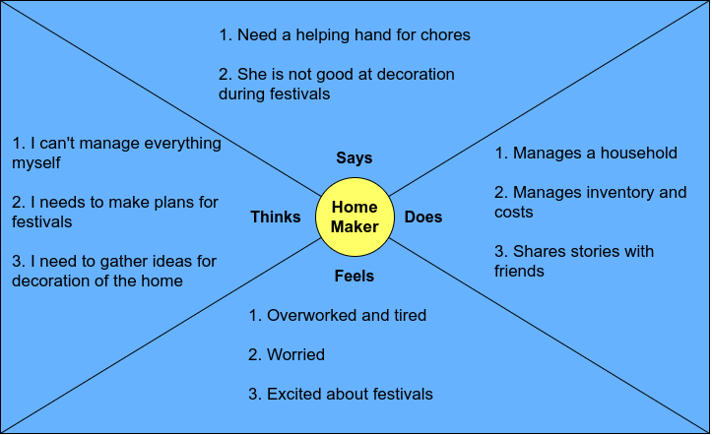
EMPATHY MAP 1

Slide 7
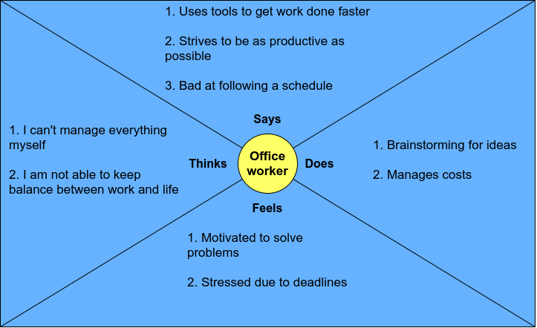
EMPATHY MAP 2

Slide 8
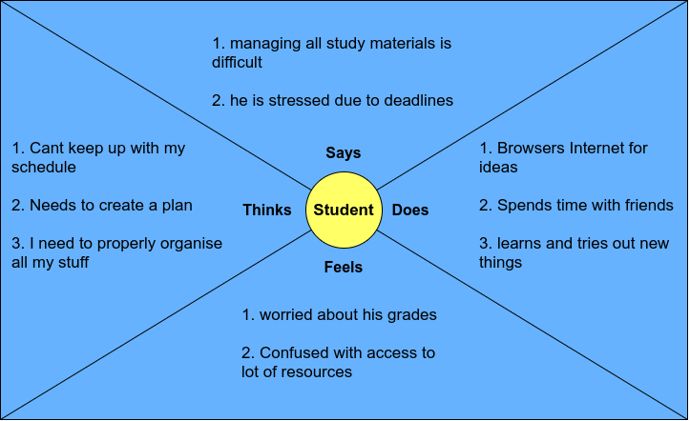
EMPATHY MAP 3

